Slide 1

Design booklet
What is it and how can it be used?

Slide 2
Introduction to design booklet
Design booklet – training session
The Design Booklet is a result of many requests from sales/area managers for a tool to help facilitate discussions with PHB’s in initial meetings and beyond.
It is a tool that can:
quickly give inspiration
quickly facilitate a discussion of how easily VELUX solutions can be integrated into the design, structure and marketing of a Professional House Builder’s (PHB) home designs
illustrate how this can grow their business far beyond the specification of a product
bridge to/from our other PHB design services
become a reference document for PHB design teams – helping to educate them on better design in relation to daylight and natural ventilation
facilitate self-driven implementation of VELUX solutions from PHB design teams
Notes:
It is a tool that helps you to bridge inspiration and great sales skills with tangible business opportunities (blue hole outcomes) at a low investment

Slide 3
First, let’s give it some context

Slide 4
Who are the Target GrouPs?
TARGET GROUPS
Alumni
Existing
Potential
Employees
Academia
Suppliers
Politicians
Authorities
Political influencers
Social Media
influencers
Journalists
Media
Engineers
Commercial architects
Residential architects
Specifiers
eDealers
Decor
DIY
Builders Merchants
Dealers
Carpenters
Installers
Housing associations
Professional Building
Owners-PBO
End-users
Contractors/
Sub-contractors
NGOs
Local society
Home owners
Tenants
Windows speciality retailers
Professional House Builders -PHB
On-site _House Builders
Roofers
Municipality architects
Interior designers
Commercial buildings
Public
buildings
Partners
Business organisations
Developers
Remodelers
Technical schools
Design &
Architecture Universities
Roofing Specialists
Manufactory- House Builders
Associated partners (Installers, dealers, specifiers working with PHB’s)
Notes:
B2C version will target end-users and a broader range of specifiers, dealers and installers.

Slide 5
Target Roles in PHB
Project developer
Market insight
Marketing
Brand building
Co-marketing (coop with suppliers/ finance/ real estate)
Construction engineer
Site Management (time)
Owner
Reputation/ brand
Production plans (standardization/ easy and safe installation)
Market share
Growth – (own company or acquisition)
Architect
New design (create differentiation on the market/ inspiration from custom made design)
Networking (authority connections)
Price (target costumers)
Strategic Partnership (trusted and Brand valued coop)
Re-vitalized design (use of existing best selling models with upgraded features)
Attract customers B2C (show houses/ advertising/ online/ SoMe/ testimonials)
Create volume (reuse existing construction elements)
Create volume (price)
Technical/ building code handling (new developments/tools and materials)

Slide 6
Target Roles in PHB
Site manager
Control of internal/external deliveries (timing and quality)
Finance
Internal - sales offer tailored to clients needs and ability (risk assessments)
Purchaser
Project manager
Control of all internal/ external value chains process (planning and supplier terms/ contracts)
Trade conditions (price, quality, delivery and installation processes)
Sales staff
Promoting and guidance of clients (insight in customers needs)
Control of subcontractors
Offer extra packages (finance, service and additional product solutions)
After sales (knowledge of home owners and new trends)
External coop finance Bank/credit (branding - cash flow - security of PHB product)
Create volume (stock and price)
Notes:
The design booklet is structured in a way that allows you to connect with people from any one of these roles – you can tailor the discussion accordingly using the different features/text as a touch point.

Slide 7
How do we currently work with the target groups?

Slide 8
Customer journey PHB’s
experience mapping
Inspire from business, finance marketing & design angles
Securing the category
This is about winning the customer of which the initial business case considered as most important
Securing the brand/Sales
Ensuring the VELUX roof window and developing the customer
(e.g. offering add-on services, which will hurt if the PHB changes the brand)
Business case
and financing
Develop new skills
Negotiate with
suppliers
Strategic
partnerships
Build
show house
Marketing the
show house
Purchase materials
from suppliers
Technical service
from suppliers
Marketing and PR
Seek inspiration
Develop new
house concepts
Marketing
and branding
Production
drawing
Train sales
personnel
Upsale: discuss
materials with
end-user
Delivery of
materials
Check/After
sales
New project starts
Weak presence
Medium presence
Strong presence
Notes:
All of the roles we just saw have different levels of responsibility and decision making power at different stages of the PHB project journey. It is important that we can connect with each role in a way that speaks to their priorities and communicates the value of a roof window solution in their stake of the PHB operation.
Often by the time VELUX is involved in a project it is already in the ‘securing the brand’ phase – to increase our relevancy it’s important that we are involved from the beginning of a project where we have an opportunity to influence the key decision making that will ‘secure the category’ (that roof windows will be a key part of the design).

Slide 9
Work – process flow
VELUX – PHB Key Account Management
Select PHB/ PBO
Important player: number of houses per year/ operation in more countries
Influent players at national or regional level (i.e. member of house builders associations or trendsetters/media)
Obtain commitment
Investment in your business
Implement
Joint communication. Strategy plan according to PHB preferred tools:
- web, print, medias
- On site communication (demo houses)
- local/regional fairs
- etc.
Communicate towards end-users
Differentiation in the market
Create a win-win situation
Win/win agreement
Join PHB demo houses-new/existing, including product placement
Re-design of selected models, 3D renders including before and after VELUX, VR
customized daylight & indoor comfort analysis: best selling type house model/new house lines
Important owners: Housing associations/ municipalities with large portfolio - apartments/ row houses/ schools…..
Get the meeting, prepare, execute – gain commitment in business partnership through tailored offering.
Notes:
Obtaining commitment can be difficult. Of course the first step is to get the meeting. The Design Booklet can be a valuable tool in turning that meeting into a tangible opportunity. Each meeting needs to be tailored to who is sitting in front of you but if you have done your research it’s possible that in the first meeting you can talk them through a specific daylight solution they could integrate into a specific design with a supporting business, health, design and customer satisfaction case.

Slide 10
Project Plan
Planning execution
Tailored Offering Phase
Building Phase
Event
New project/ Next level
Post event/ Follow up
Case Development
Notes:
By inspiring all key stakeholders within the PHB and gaining commitment to the partnership you not only secure the category but also the brand. The danger with only inspiring the design team is that the brand can later be lost to a competitor by influence from the finance or business figures within the PHB decision making.

Slide 11
List of Services/ Tools to PHB’s & PBO’s
Building Industry
BI Services | Amount
Redesign | 1 or more project
New design | 1 or more project
Daylight analysis | 1 or more project
EIC analysis (Energy and Indoor Climate) | 1 or more project
Active House Calculation | 1 or more project
Active House Verification (external) | 1 or more project
3D Renders | Entire House: Interior (6-8) Exterior (2)
3D film
VR - Virtual Reality - light version on app
VR - Virtual Reality in "flagship version" HTC glasses and full VR | 1 or more project
POS in show house and sales centers: special designed to fit showing the PHB projects with the 3D, could include VR, accessories | TBD
Show house: products delivered, Open Days contribution, media communication and PR, training on VRW's installation, training of sales staff in the show houses | Spilt the services into single price and create the agreed complete package price
Professional pictures with shared global rights ready before Open Day, for media and marketing communication (press kit) | 1 or more project
Development of project case on marketing website, for the project to be shown on V-xxx and with link to PHB's website and vice versa | 1 or more pages
Upgrade of existing Show Houses: VELUX in, competitors out Redesign with better/more VRW and more VELUX products (V-Active, motors, blinds, shutters) Support After Sales Service | 1 or more project
Building site sign layout
Printed Sales material - Dossiers with PHB's project, layout and print by VELUX, or shared costs
Notes:
The Design Booklet is another tool in the ‘toolbox’ for creating a tailored service for PHB’s & PBO’s.
It is a low cost investment that can help get ‘the foot in the door’ of important PHB’s, leading to a bigger commitment from them (to share drawings and get the co-op agreement on the table), or it can be an alternative when a PHB is not quite big enough to justify the higher investment but is enough to inspire them to see the value in a roof window solution and integrate these into some of their designs and possibly influence how they market the benefits to their customers.

Slide 12
HOW IS THE WORKFLOW REFLECTED IN THE DESIGN BOOKLET?

Slide 13
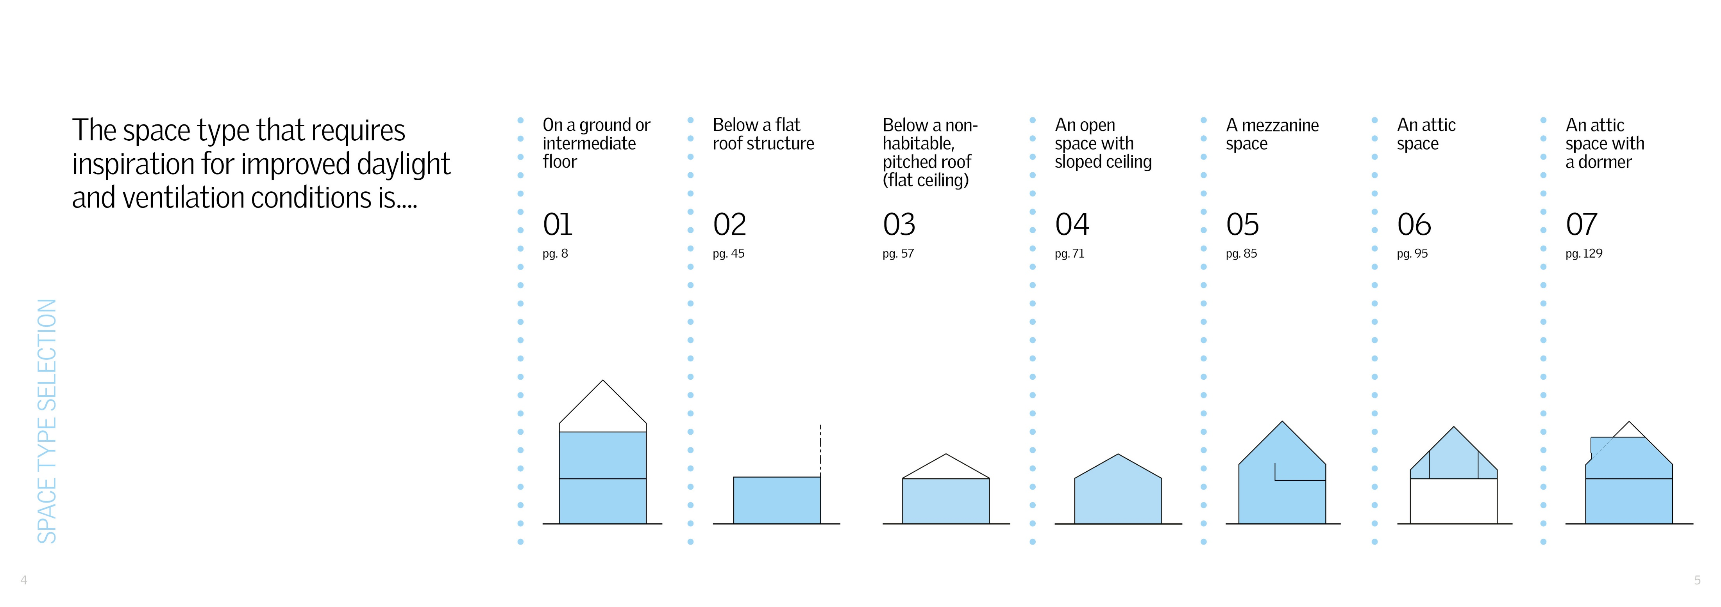

Space type categories
Design booklet – training session
The projects and inspiration have been divided into space type categories that engage with the technical nature and practical implementation of the solutions.
Notes:
We know that getting straight to the point – what is actually feasible (not just inspirational) – is very important to how successful a conversation is with a PHB, the space type icons make it fast to recognise what solutions are possible in a given design. The icons are simple and understandable to people without a design background – so no matter who you have in the meeting, they can follow and understand the proposal.

Slide 14
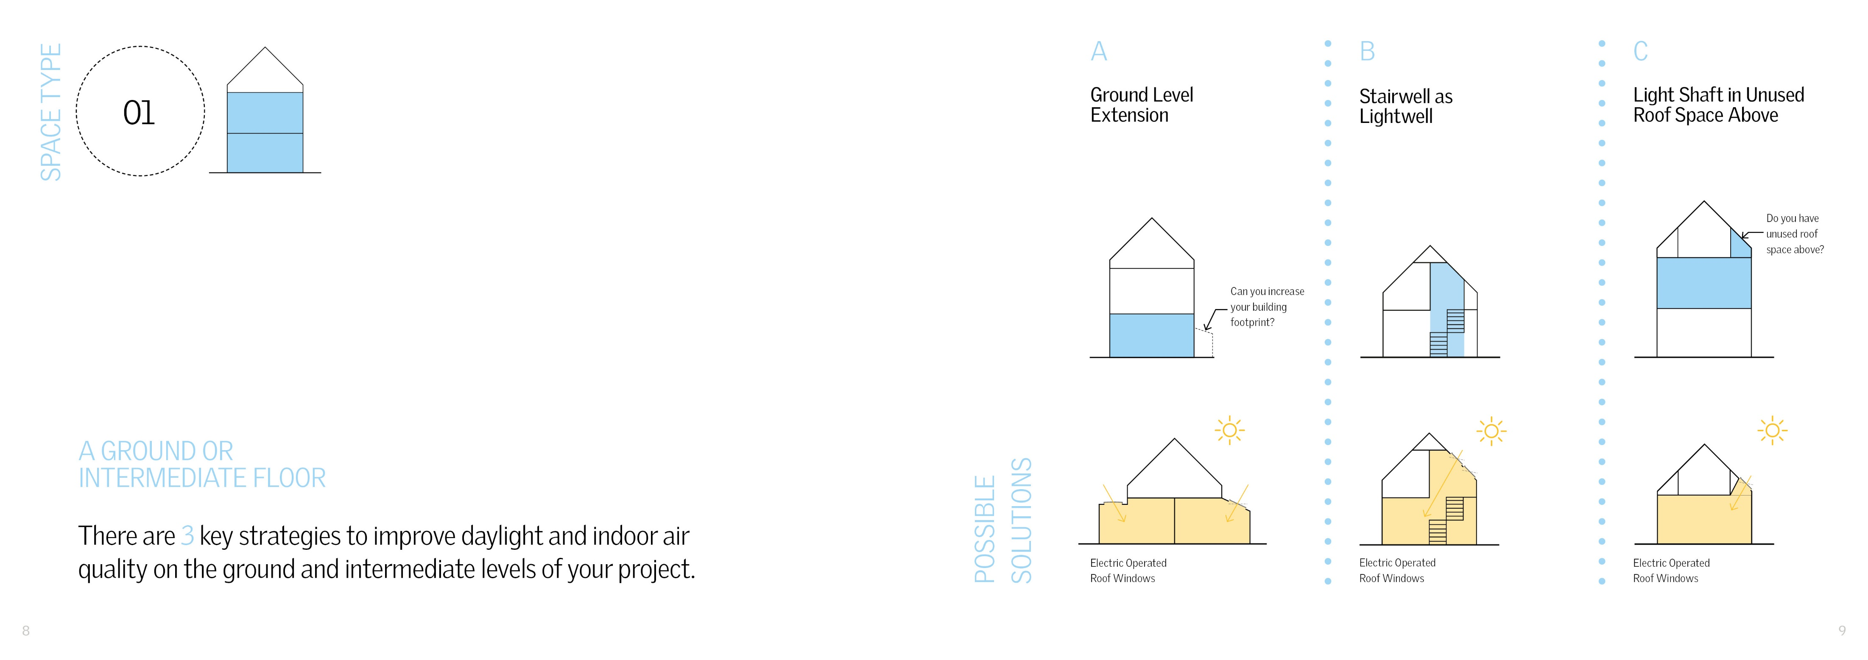
solutions
Design booklet – training session
Notes:
Within each space type chapter of the Design Booklet, you will find examples of different room types complemented with arguments addressing design, marketing and business opportunities that the PHB can benefit from by integrating the solution.

Slide 15
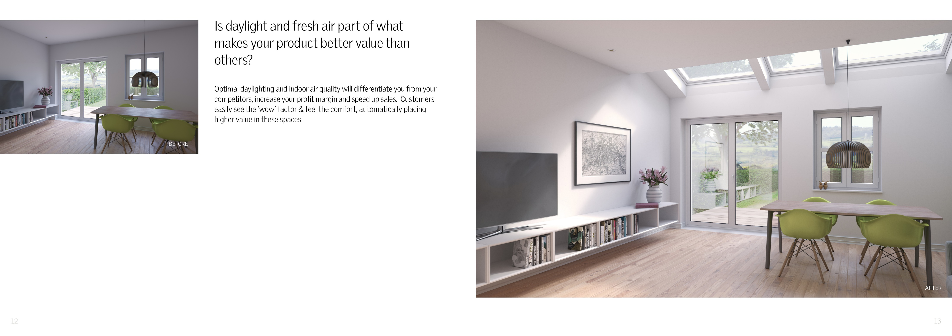
Inspiration
Design booklet – training session
Notes:
The content aims to inspire not only better designs but for the PHB to build their business by using VELUX solutions

Slide 16
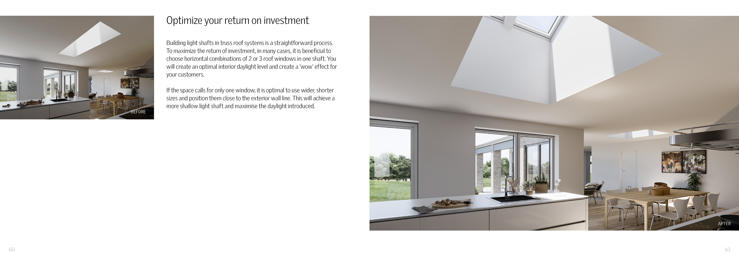
Inspiration
Design booklet – training session
Notes:
It uses language that will capture their attention

Slide 17
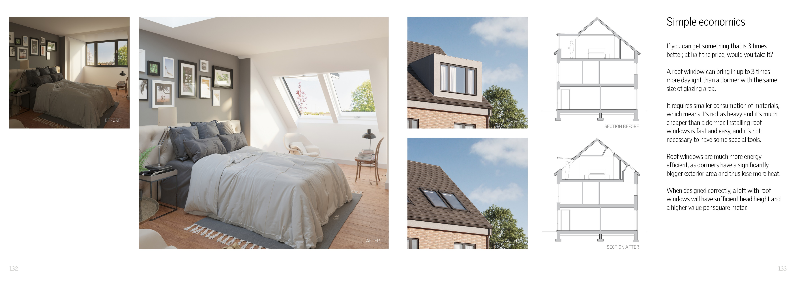
education
Design booklet – training session
Notes:
Inspiring through educational elements. After working on such a large volume of similar projects with PHB’s we began to recognise obvious patterns in the poorer elements of many PHB designs and wanted to address these directly with simple VELUX solutions that we would typically recommend. This means you can be more targeted about which PHB projects you might wish to put resources into by using our more in depth design services and which projects you can secure by simply creating your own analysis of the design and use examples from the design booklet to suggest how value could be added through a roof window solution.

Slide 18
Customer journey PHB’s
experience mapping
Securing the category
This is about winning the customer of which the initial business case considered as most important
Securing the brand/Sales
Ensuring the VELUX roof window and developing the customer
(e.g. offering add-on services, which will hurt if the PHB changes the brand)
Business case
and financing
Develop new skills
Negotiate with
suppliers
Strategic
partnerships
Build
show house
Marketing the
show house
Purchase materials
from suppliers
Technical service
from suppliers
Marketing and PR
Seek inspiration
Develop new
house concepts
Marketing
and branding
Production
drawing
Train sales
personnel
Upsale: discuss
materials with
end-user
Delivery of
materials
Check/After
sales
New project starts
Educate to support self-driven implementation of roof window solutions. Other services & strong relationships help secure the brand.
Weak presence
Medium presence
Strong presence
Notes:
When you are starting a new relationship with a PHB or just starting out working with this target group you may need to allocate higher investments into services and support to secure the category and the account, but once the relationship is established the PHB should be able to start integrating VELUX solutions into other projects as they now already see the value in the solutions. The design booklet helps them in this transition by becoming a reference book for the PHB design team.

Slide 19
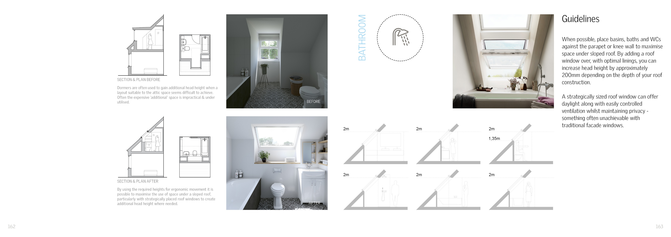
education
Design booklet – training session
Notes:
We have also included technical tips that will help to correct poor design but also result in the booklet becoming a reference book for PHB in house designers.

Slide 20
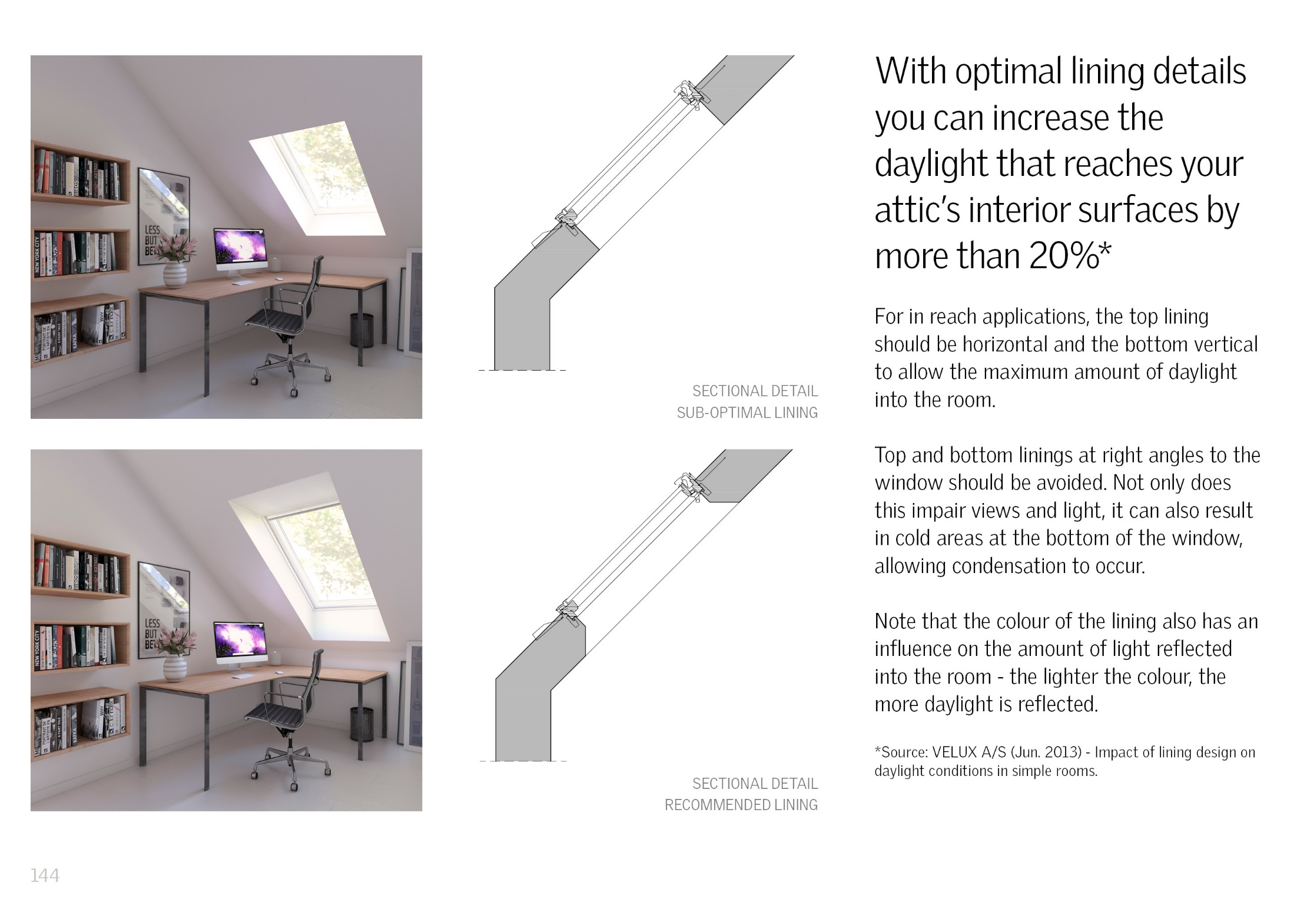
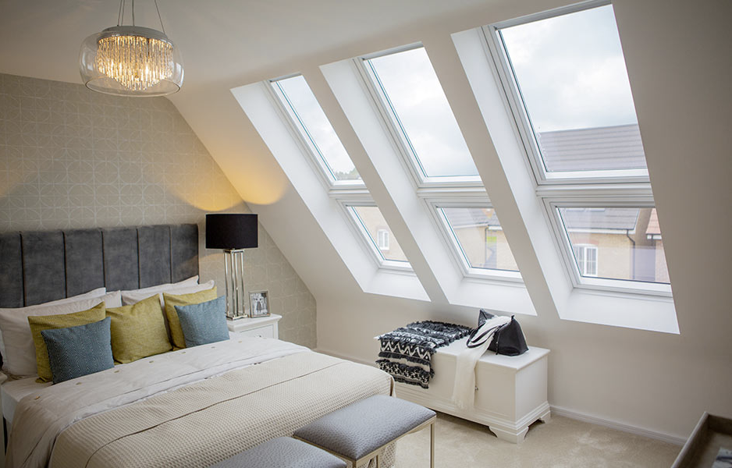
education
Design booklet – training session
Notes:
We know that linings are an example of one of the most commonly repeated faults in the PHB projects we work on. From our time spent on the road with area managers we also knew there was some difficulty explaining in a fast, simple way that it would benefit the PHB’s to make sure their trades completed the linings in the VELUX recommended way. We hope that the linings chapter can help.

Slide 21
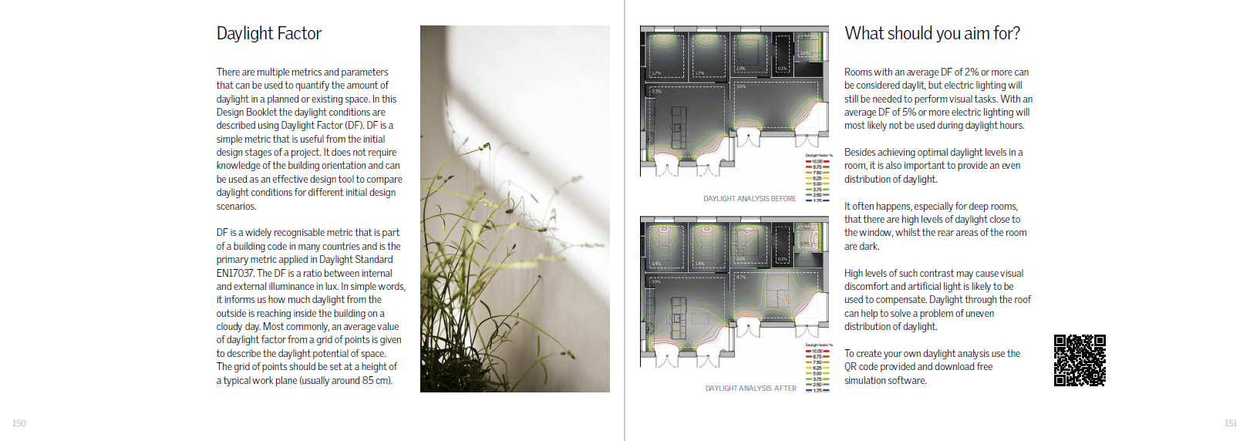

Promote Tools
Design booklet – training session
Notes:
Encourage their design team to download and start using daylight vizualiser as a way of testing how their current designs perform in terms of daylight – we are always happy to support with training

Slide 22
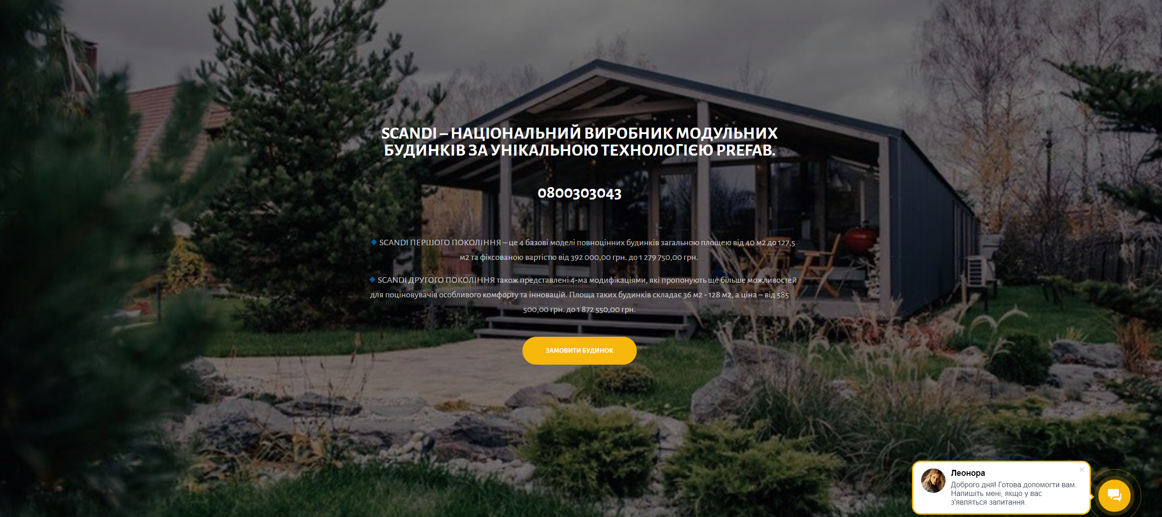
HOW MIGHT THIS LOOK IN PRACTICE?
Design booklet – training session
Let’s take an example scenario… https://xn--80aiqnr4k.xn--j1amh/
Notes:
Let’s say I have a first meeting with PHB ‘Scandi’ coming up…
I would take a look through their current catalogue of the homes – looking for a good example that could start the discussion around how they could integrate VELUX solutions & why.

Slide 23
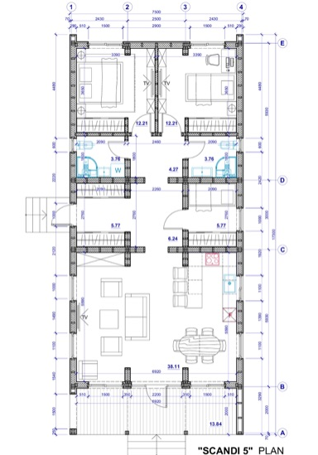
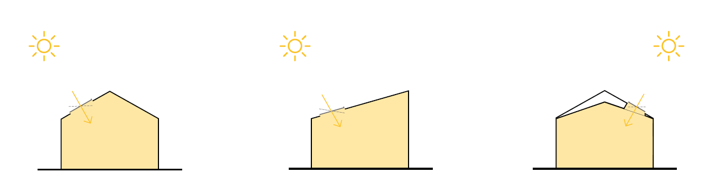
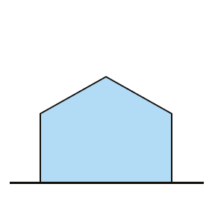
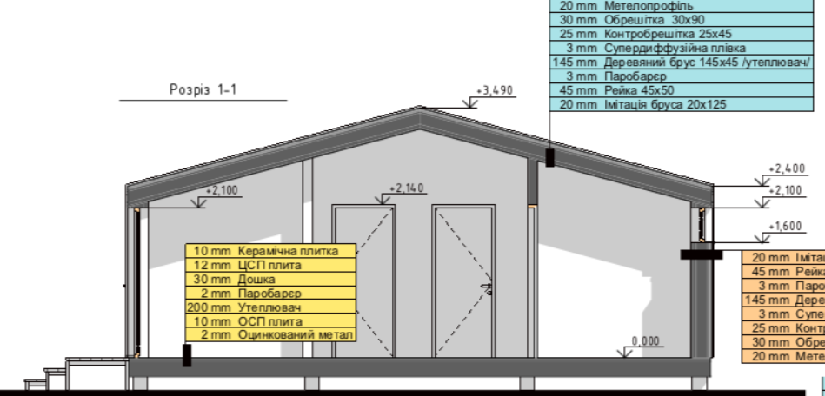
Fast assessment of space types
Design booklet – training session
04
https://velux-bi.foleon.com/designbooklet/eng/space-type-04/
Notes:
In this case we can quickly see that their designs fall into the ‘Space Type 04’ category. Looking at the company’s branding we can also see there is a good opportunity for us to position ourselves as a valuable partner by offering not only design inspiration but support in marketing and communication around the benefits and quality of a VELUX solution (including the strength of the Scandinavian brand).
Having tangible solutions to their specific designs ready to present in a meeting can be a great step towards gaining understanding & acceptance from the PHB for a more in depth collaboration – e.g. design services, co-operation agreement.
Perhaps the PHB is not big enough to warrant the investment of our full design services - offering this tangible implementation and providing them with the design booklet tool can mean they can still become ‘ambassadors’ of our solutions at an investment proportionate to their business size.

Slide 24
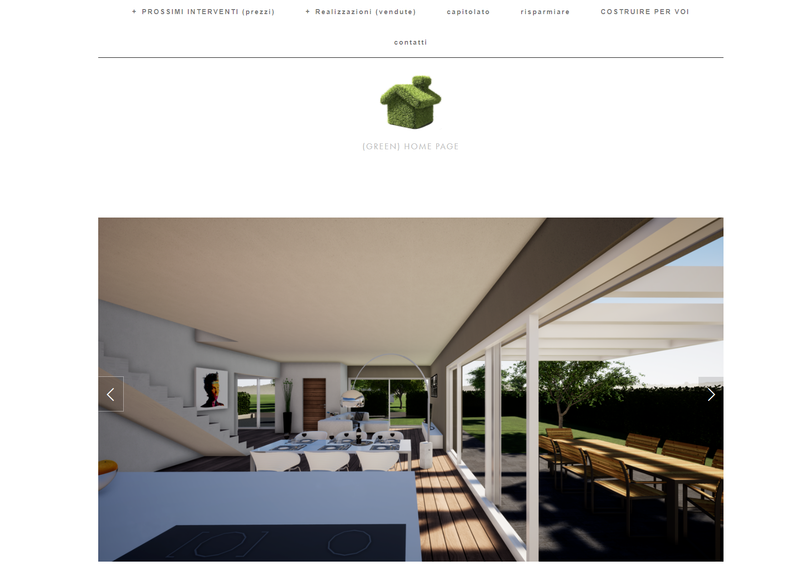
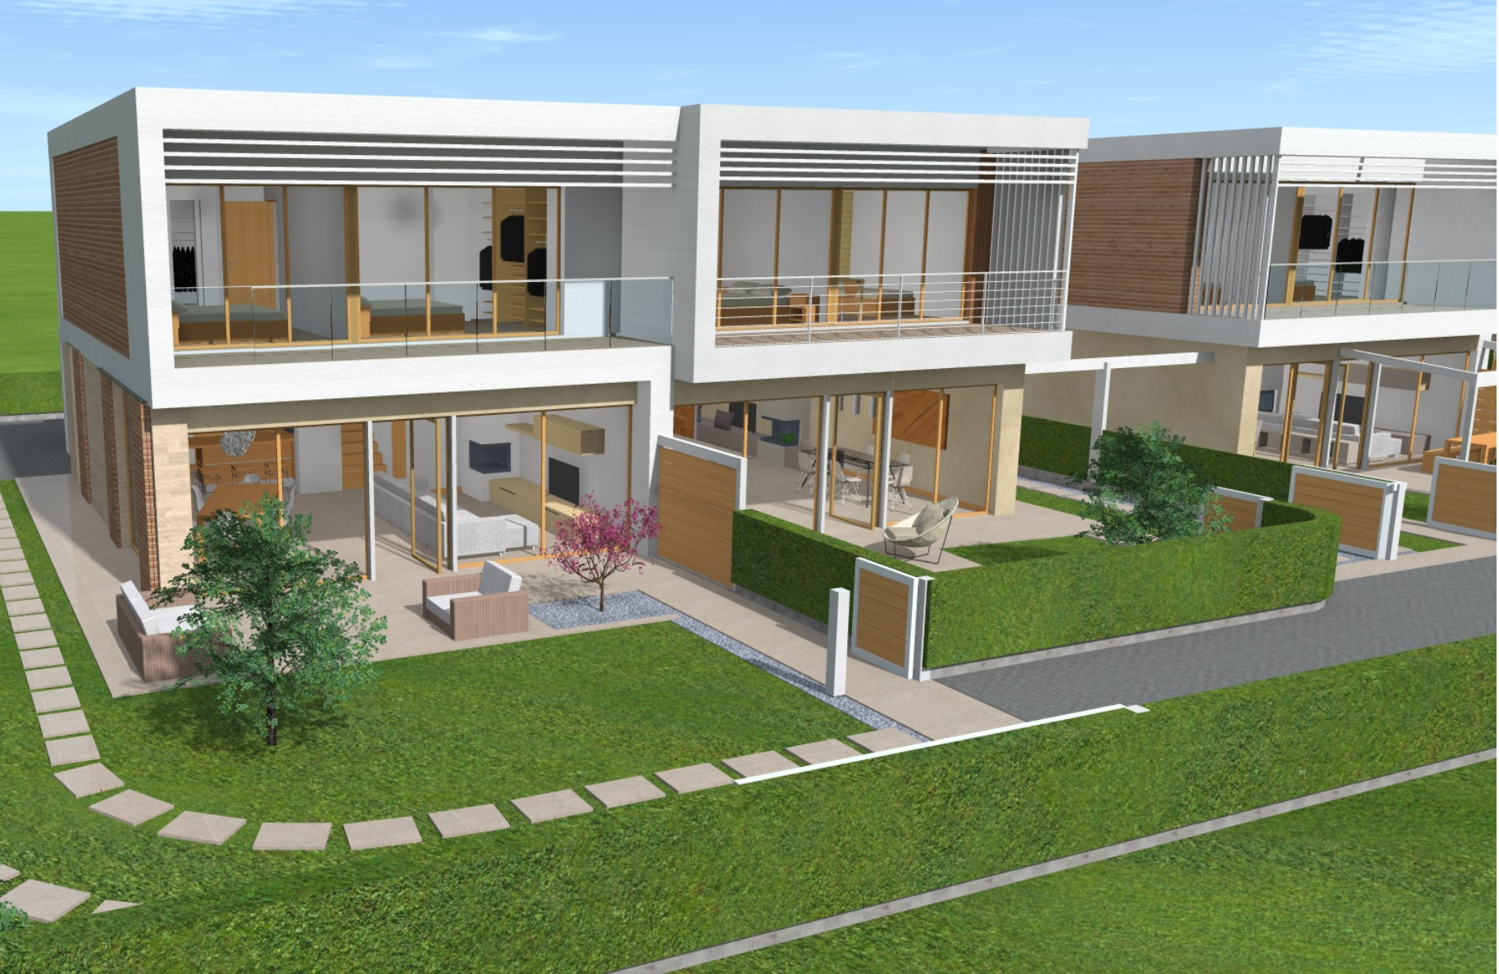
HOW MIGHT THIS LOOK IN PRACTICE?
Design booklet – training session
Let’s take another example scenario… http://www.green-house.it/
Notes:
This time in Italy…

Slide 25
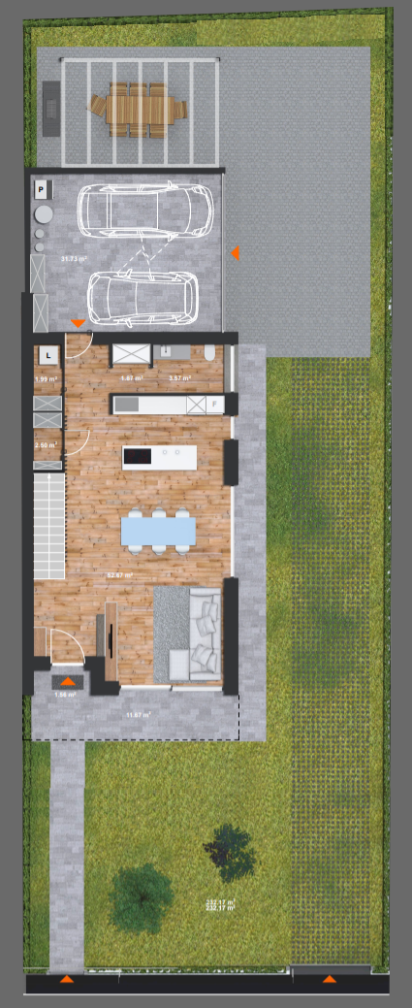
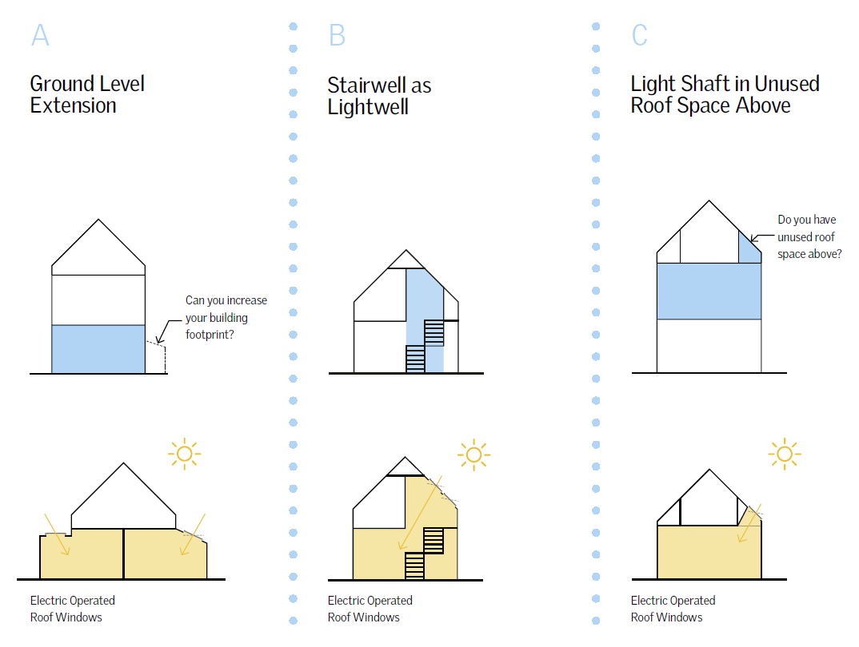
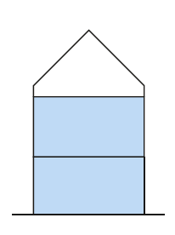
Fast assessment of space types
Design booklet – training session
Lower level:
01
https://velux-bi.foleon.com/designbooklet/eng/space-type-01-a/
Notes:
Here we can see that the lower level of the home has windows only on two facades because it is built in a duplex configuration. This means the spaces along the back side will be very dark and the stairs will need electric lighting to be safely used.
Of course we can see that the lower level falls into space type 01. It is certainly possible to suggest that they may find Space Type 01A inspirational but given the layout I would be most inclined to talk through Space Type 01B giving them insight into the benefits of using the stairwell as a lightwell.

Slide 26
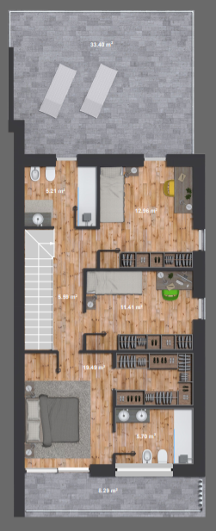
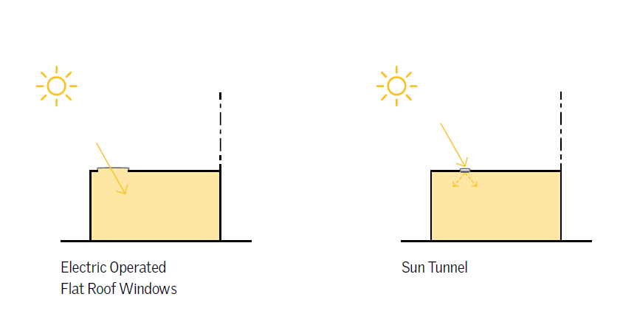
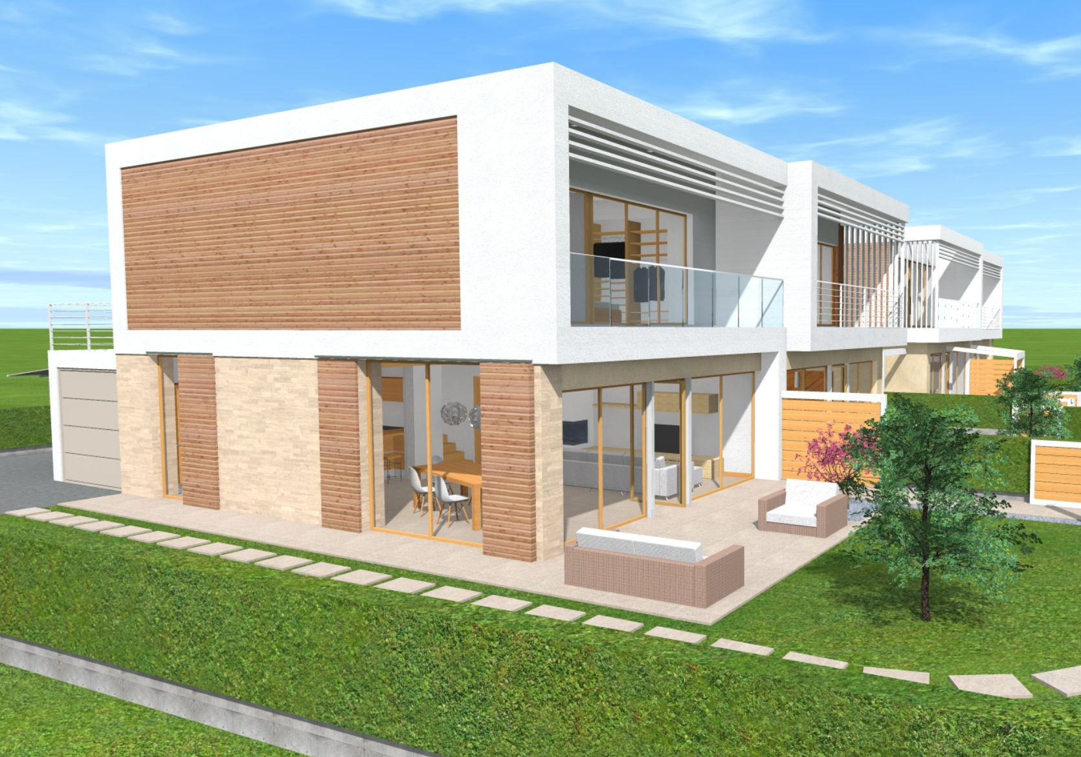
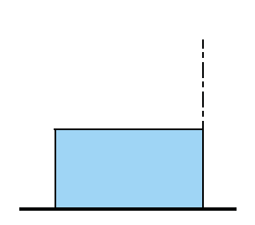
Fast assessment of space types
Design booklet – training session
Upper level:
02
https://velux-bi.foleon.com/designbooklet/eng/space-type-02/
Notes:
On the upper level I can see the design has a flat roof and therefore easy to categorise into ‘space type 02’. So I now know that I can also talk them through opportunities presented in this section of the book. You might also find some favourite supportive text amongst other space type categories – using the digital version you can quickly navigate to these and back to the relevant space type. https://velux-bi.foleon.com/designbooklet/eng/01b-03/

Slide 27
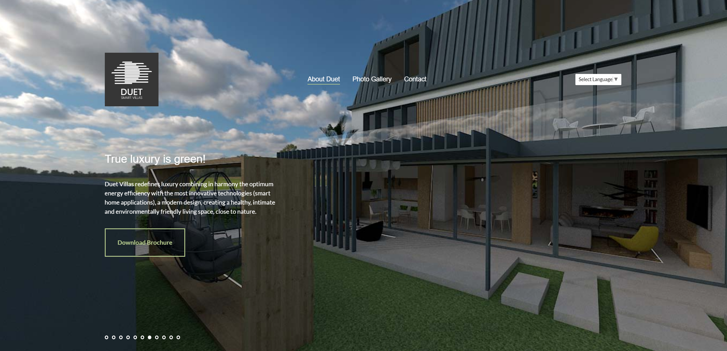
Are they already using velux products?
Design booklet – training session
Let’s take one more example, this time of an existing customer…
https://duetvillas.ro/
Notes:
We can see that Duet Smart Villas are already a VELUX customer… but there is always more to achieve.
They already know the value of roof windows and lighting but perhaps we can deepen their understanding of what is possible, what benefits can be associated and how to market this to customers.

Slide 28
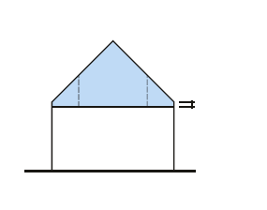
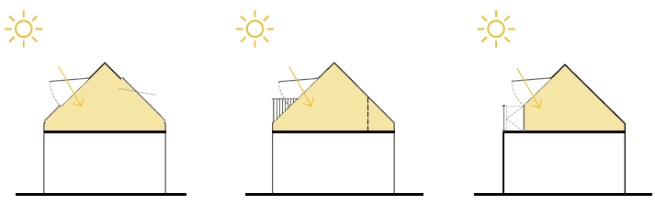
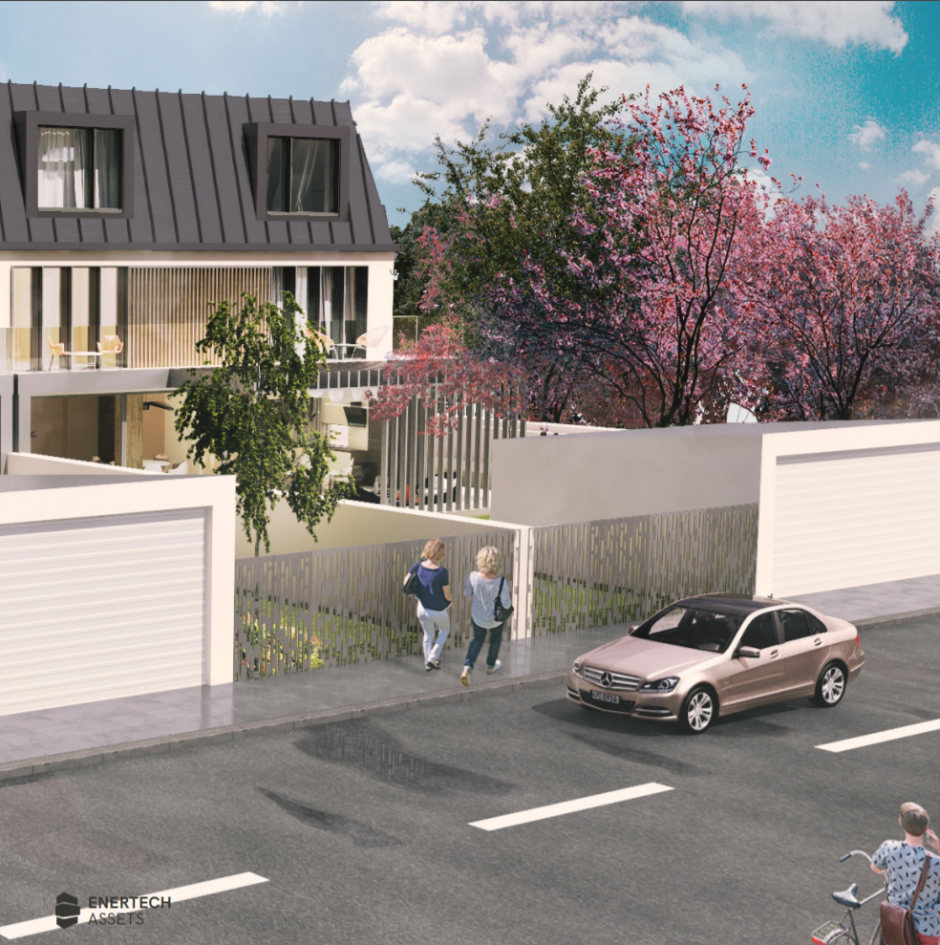
What haven’t they thought of?
Design booklet – training session
Attic Level
06
B
07
*We can see they are using dormers towards the street façade on the attic level. Have they considered a GIL combi instead?
https://velux-bi.foleon.com/designbooklet/eng/space-type-01-c/

Slide 29
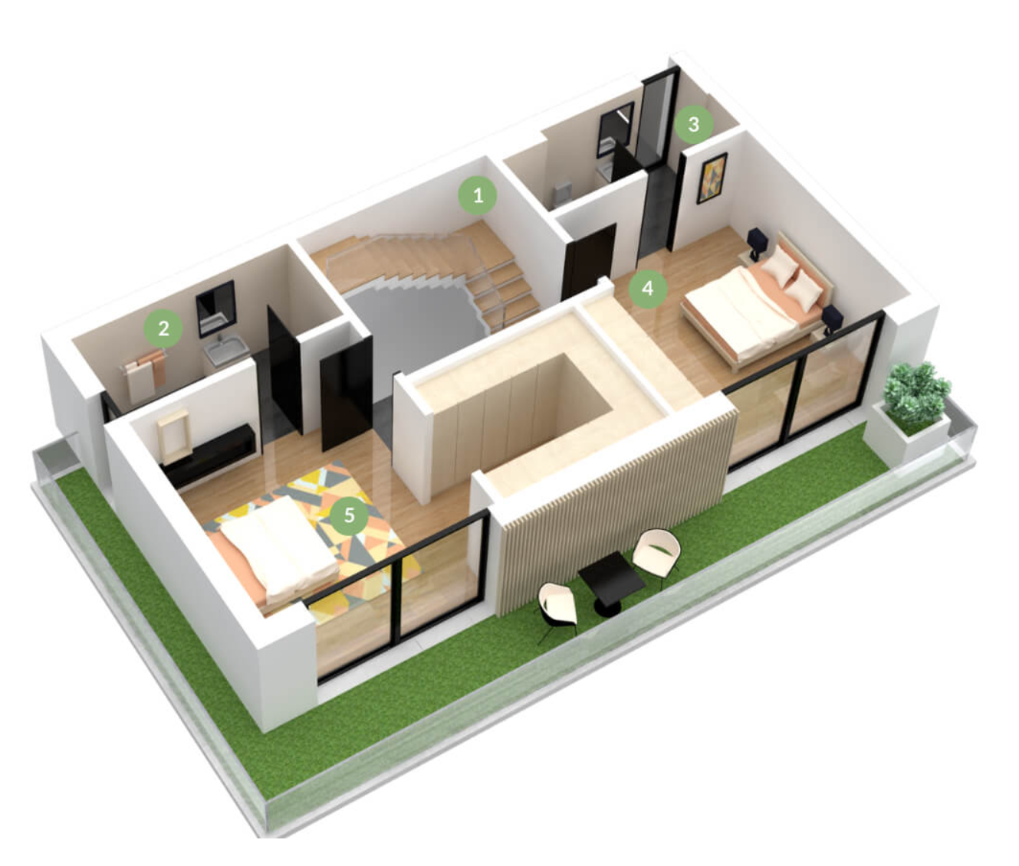
Are there new opportunities?
Design booklet – training session
Intermediate Level
01
https://velux-bi.foleon.com/designbooklet/eng/space-type-01-a/

Slide 30
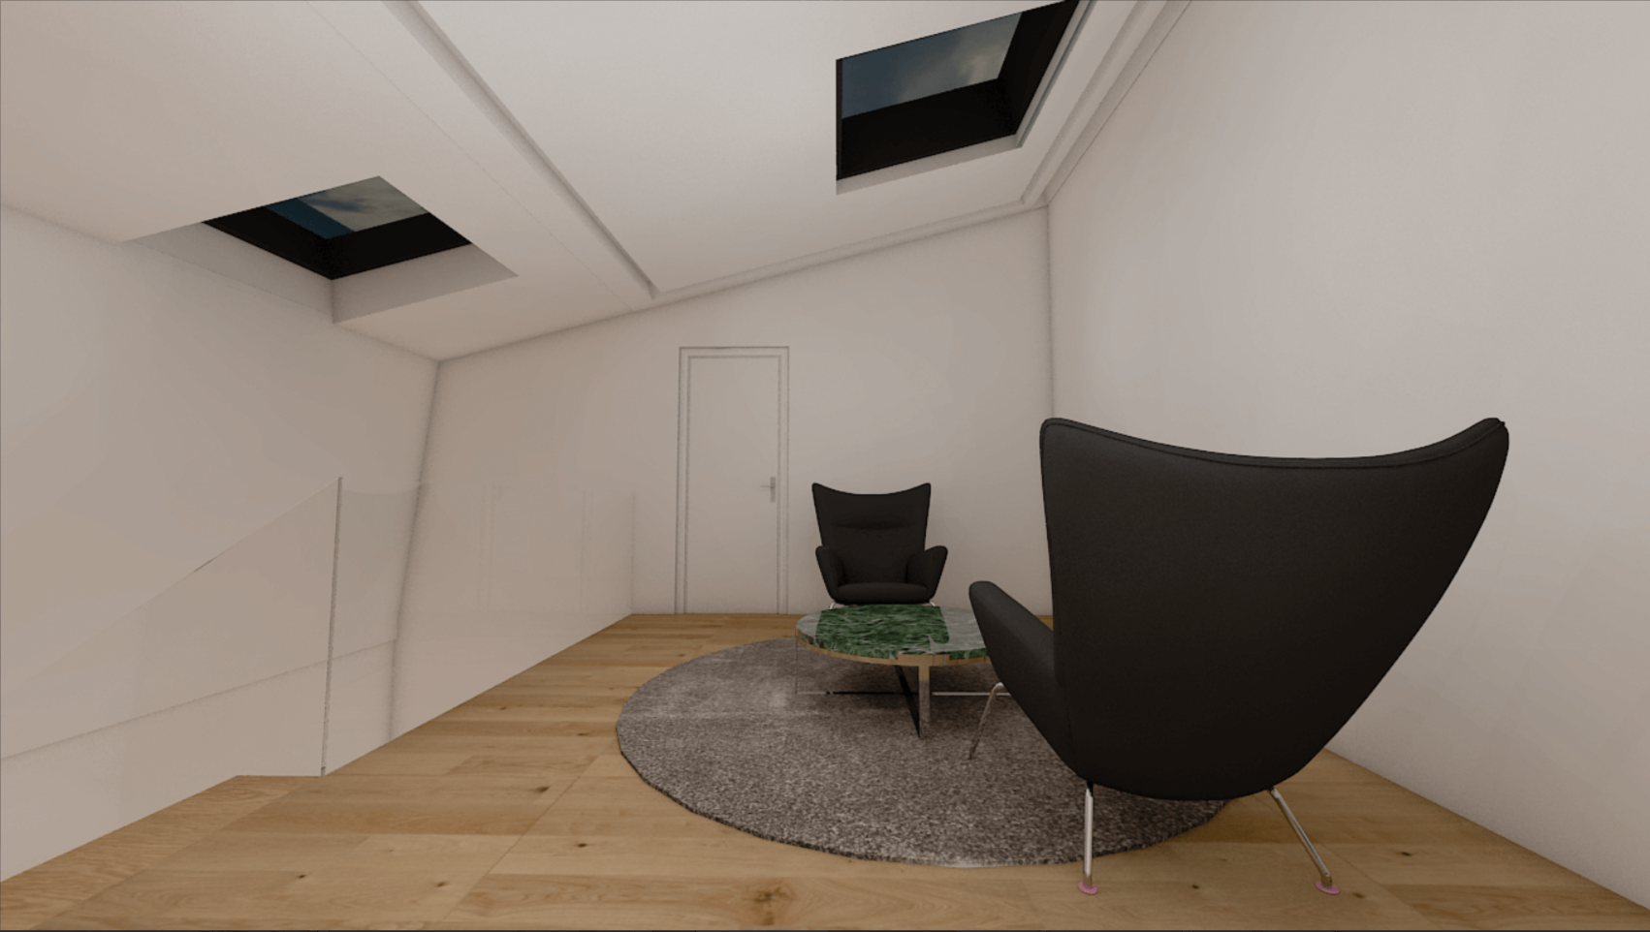
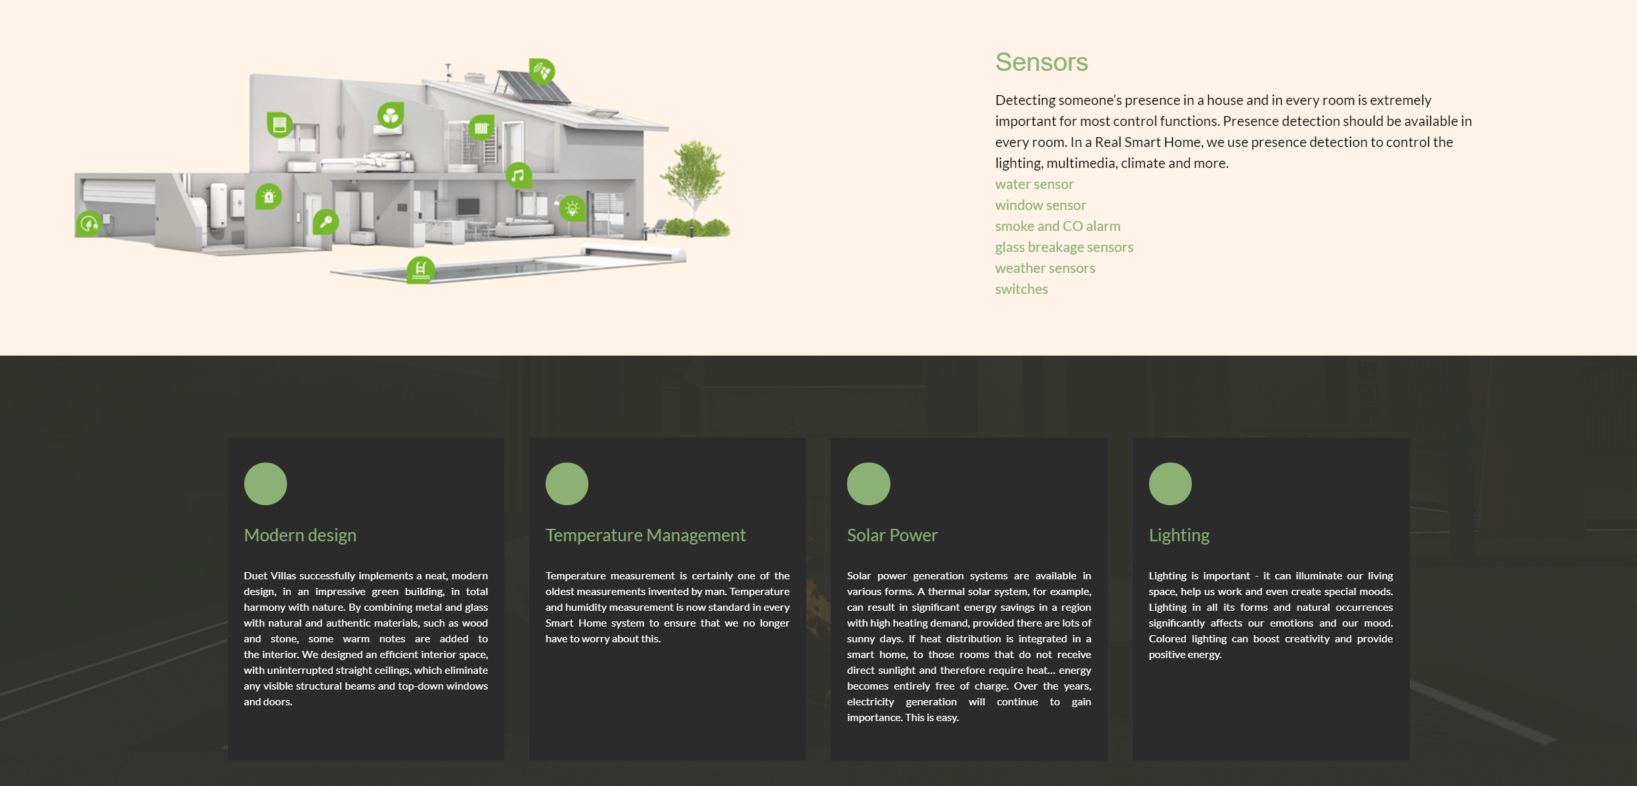
Help them to optimise benefits
Design booklet – training session
We can see they are making an effort to raise awareness of the benefits of good lighting and smart design but there is clear space for us to support in their communication around this.
Can the size or linings be optimised?
Do their customers know the benefits of the ‘stack effect’ ventilation that roof windows provide?
Can they use some of the messages from the design booklet to incorporate into their own marketing material?

Slide 31
Physical or digital?
Design booklet – training session
Digital Design Booklet
Can be used to facilitate discussion in virtual meetings
Positioned on PHB landing page to help drive traffic & increase PHB’s interest in establishing relationship/access to broader VELUX design services
Easily shared through linkedin/Social media/email
Easily shared by PHB with their own network
If shared via email should be considered what kind of introduction to give – whether to use this as a draw card to lock in a meeting, ‘sign up’ to other services etc.
Includes VR content, videos etc.

Slide 32
Physical or digital?
Design booklet – training session
Physical Design Booklet
Should be on hand, ready as a ‘give away’ in any new PHB meeting or in follow up meeting where design is being presented
Encourage to be used as a ‘reference’ book by PHB design team/in-house architects – if design has been presented point out which space types were in the design & help them to see how they can start to replicate these principles across their ‘portfolio’
Encourage PHB to share with their marketing team – point out that the information in the booklet can also be used to market their designs as healthy homes and potentially increase sales & speed of sales
Point out that if a client is interested in a design that includes roof windows/sun tunnels the PHB can flick through the booklet with them, helping to educate their customer on the benefits they will experience living in this home & help to differentiate their design from others.

Slide 33
Can it be used for groups other than phb’s?
Design booklet – training session
YES!
Of course it can, just keep in mind that at this stage some of the text is quite specifically targeting PHB’s. If you wish to share with another target group just keep in mind that it may need a little extra introduction.
We are also currently working on a B2C version that will replace any text that includes direct ‘business’ references with alternative text on architectural/health/end user benefits.

Slide 34
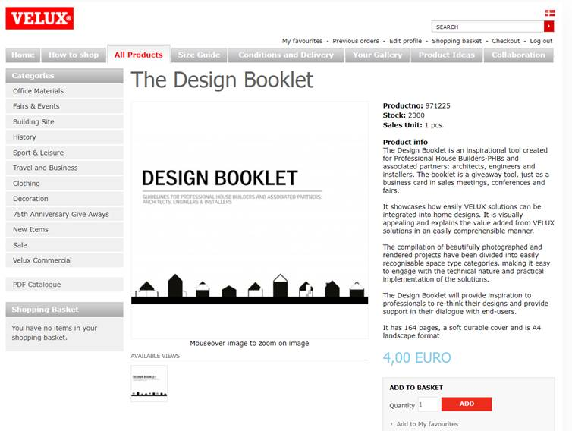
Where can you find it?
Design booklet – training session
English version now available in GAS

Slide 35
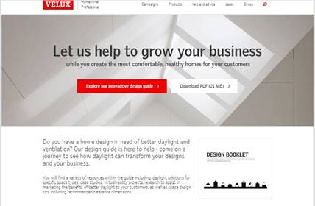
Where can you find it?
Design booklet – training session
Contact your local webmaster and request integration of our ‘Design Support’ (housebuilders) landing page into your local site.
https://www.velux.co.uk/professional/housebuilders

Slide 36

twitter.com/VELUX
facebook.com/VELUX
youtube.com/user/VELUX
linkedin.com/company/VELUX
pinterest.com/VELUXGroup/

